Slide 1
UNIT-1

Slide 2
WHAT IS CLOUD COMPUTING
DEFINITION:
Cloud definition: The internet is represented as cloud in network diagrams. Cloud computing is an application-based software infrastructure that stores , manage, and process data on remote servers rather than a local server or a personal computer. which can be accessed through the internet.

Slide 3
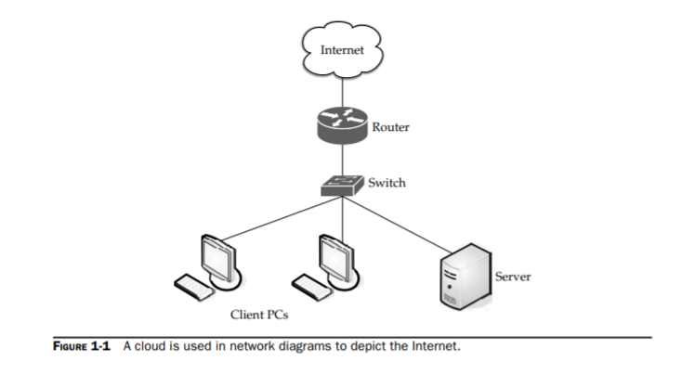

Slide 4
Examples of Cloud Computing Services
Amazon EC2 — Virtual IT.
Google App Engine — Application hosting.
Google Apps and Microsoft Office Online — SaaS.
Apple iCloud — Network storage.
DigitalOcean — Servers (Iaas/PaaS)

Slide 5
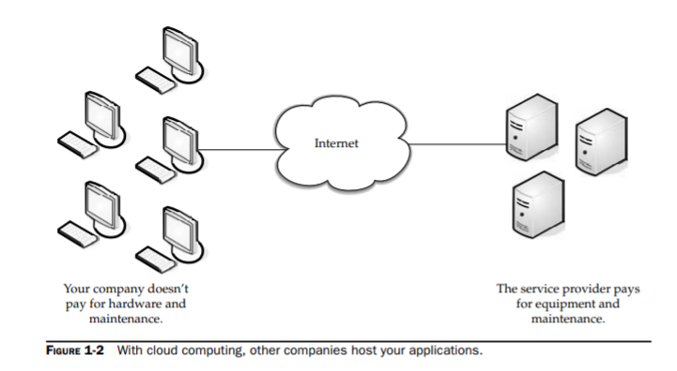
What Works

Slide 6
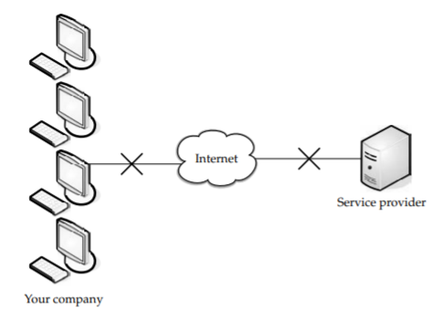
Limitations of cloud
Your sensitive information
Protect your data
Weak links

Slide 7
Application integration issues
Applications not ready

Slide 8
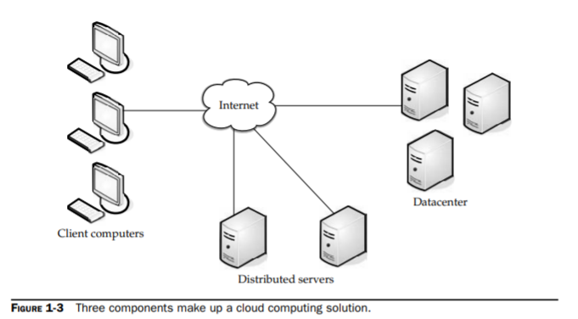
Cloud components

Slide 9
Clients (Mobile ,Thin & Thick)
Advantages of Thin:
lower hardware cost
Lower IT costs
Security
Data Security
Less power consumption
Ease of repair or replacement
less noise

Slide 10
Data center
Distributed servers

